Slide 1


Noida Institute of Engineering and Technology, Greater Noida
WEB DEVELOPMENT USING MEAN STACK
Unit: III
Basics of Angular Js
RITESH KUMAR SINGH
(Asst. Professor)
CSE Department
Course Details (B. Tech. 6th Sem)

Slide 2
Faculty Introduction
Name | Ritesh Kumar Singh
Qualification | Diploma, B.Tech., M. Tech., PhD. Pursuing
Designation | Assistant Professor
Department | Computer Science & Engineering
Total Experience | 5 years
NIET Experience | 4.5 years
Subject Taught | Web development using python with Django, Web Development using Mean Stack, Problem Solving using Advance Python, Problem Solving using Python, Programming for Problem Solving using C, Database Management System.

Slide 3

Evaluation Scheme

Slide 4
Syllabus
UNIT-I: Introduction to Nodejs
Installing Nodejs, Node in-built packages (buffer, fs, http, os, path, util, url)Node.js modules, File System Module, Json data, Http Server and Client, Error handling with appropriate HTTP, Callback function, asynchronous programing REST API’s(GET, POST PUT, DELETE UPDATE), Graph, Promises, Promise Chaining, Introduction to template engine (EJS).

Slide 5
Syllabus
UNIT-II: Express Framework
Configuring Express, Postman configuration, Environment Variables, Routing, Defining pug templates, HTTP method of Express, URL binding, middleware function, Serving static files, Express sessions, REST full API’s, FORM data in Express, document modeling with Mongoose.

Slide 6
Syllabus
UNIT-III: Basics of Angular js
Typescript, Setup and installation, Power of Types , Functions Function as types Optional and default parameters, Arrow functions, Function overloading, Access modifiers, Getters and setters, Read-only & static, Abstract classes, Interfaces, Extending and Implementing Interface, Import and Export modules.

Slide 7
Syllabus
UNIT-IV: Building Single Page App with Angular js
MVC Architecture, One-way and Two-way data binding, AngularJS Expressions, AngularJS Controllers, AngularJS Modules, adding controller to a module, Component, Dependency Injection, Filters, Tables, AngularJS Forms and Forms validation, Select using ng-option, AngularJS AJAX.

Slide 8
Syllabus
UNIT-V: Connecting Angular js with MongoDB
Environment Setup of Mongo dB , data modeling ,The current SQL/NoSQL landscape, Create collection in Mongo dB, CRUD Operations in MongoDB. Mongo's feature set, Introduction to Mongoose, understanding mongoose schemas and datatypes, Connecting Angular with mongo dB using API.

Slide 9
Branch Wise Application
1. Real time web analytics
2. Digital Advertising
3. E-Commerce
4. Publishing
5. Massively Multiplayer Online Games
6. Backend Services and Messaging
7. Project Management & Collaboration
8. Real time Monitoring Services
9.Live Charting and Graphing
10. Group and Private Chat

Slide 10
Course Objective
In this semester, the students will
Study how to design and build static as well as dynamic webpages and interactive web applications
Students examine advanced topics like Angular, nodejs, Mongodb for web applications.
Also examine Express framework for interactive web applications that use rich user interfaces .

Slide 11
Course Outcomes (COs)
At the end of course, the student will be able to:
CO1 : Explain, analyze and apply the role of server-side scripting language like Nodejs .
CO2 : Demonstrate Express framework to design and implement dynamic web pages.
CO3 : Apply the knowledge of Typescript that are vital in understanding angular js.
CO4 : Analyze build and develop single page application using client-side programming.
CO5 : Understand the impact of web designing by database connectivity with Mongodb

Slide 12
Program Outcomes (POs)
Engineering Graduates will be able to:
PO1 : Engineering Knowledge
PO2 : Problem Analysis
PO3 : Design/Development of solutions
PO4 : Conduct Investigations of complex problems
PO5 : Modern tool usage
PO6 : The engineer and society

Slide 13
Program Outcomes (POs)
Engineering Graduates will be able to:
PO7 : Environment and sustainability
PO8 : Ethics
PO9 : Individual and teamwork
PO10 : Communication
PO11 : Project management and finance
PO12 : Life-long learning

Slide 14
COs - POs Mapping
CO.K | PO1 | PO2 | PO3 | PO4 | PO5 | PO6 | PO7 | PO8 | PO9 | PO10 | PO11 | PO12
CO1 | 2 | 2 | 2 | 3 | 3 | - | - | - | - | - | - | -
CO2 | 3 | 2 | 3 | 2 | 3 | - | - | - | - | - | - | -
CO3 | 3 | 2 | 3 | 2 | 3 | - | - | - | - | - | - | -
CO4 | 3 | 2 | 3 | 2 | 3 | - | - | - | - | - | - | -
CO5 | 3 | 2 | 3 | 3 | 3 | - | - | - | - | - | - | -
AVG | 2.8 | 2.0 | 2.8 | 2.4 | 3.0 | - | - | - | - | - | - | -

Slide 15
Program Specific Outcomes(PSOs)
S. No. | Program Specific Outcomes (PSO) | PSO Description
1 | PSO1 | Understand to shows relationships and interactions between classes or objects of a pattern.
2 | PSO2 | Study to speed up the development process by providing well-tested, proven development.
3 | PSO3 | Select a specific design pattern for the solution of a given design problem
4 | PSO4 | Create a catalogue entry for a simple design pattern whose purpose and application is understood.

Slide 16
COs - PSOs Mapping
CO.K | PSO1 | PSO2 | PSO3 | PSO4
CO1 | 3 | - | - | -
CO2 | 3 | 3 | - | -
CO3 | 3 | 3 | - | -
CO4 | 3 | 3 | - | -
CO5 | 3 | 3 | - | -

Slide 17
Program Educational Objectives (PEOs)
Program Educational Objectives (PEOs) | PEOs Description
PEOs | To have an excellent scientific and engineering breadth so as to comprehend, analyze, design and provide sustainable solutions for real-life problems using state-of-the-art technologies.
PEOs | To have a successful career in industries, to pursue higher studies or to support entrepreneurial endeavors and to face the global challenges.
PEOs | To have an effective communication skills, professional attitude, ethical values and a desire to learn specific knowledge in emerging trends, technologies for research, innovation and product development and contribution to society.
PEOs | To have life-long learning for up-skilling and re-skilling for successful professional career as engineer, scientist, entrepreneur and bureaucrat for betterment of society.

Slide 18
Result Analysis(Department Result & Subject Result & Individual result
Name of the faculty | Subject code | Result % of clear passed
Mr. Rahul Kumar | ACSE0614

Slide 19
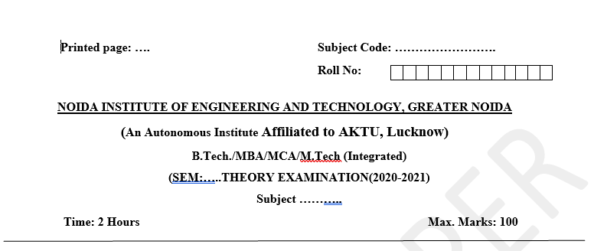
Pattern of Online External Exam Question Paper (100 marks)

Slide 20
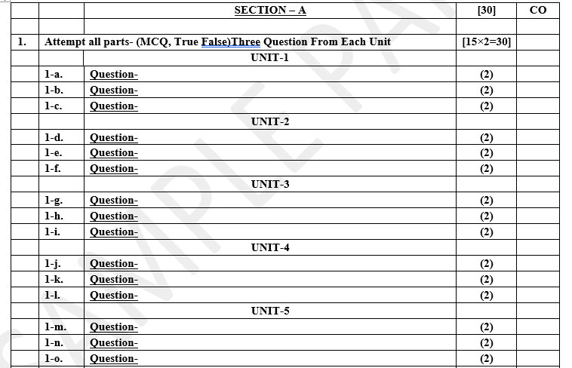
Pattern of Online External Exam Question Paper (100 marks)

Slide 21
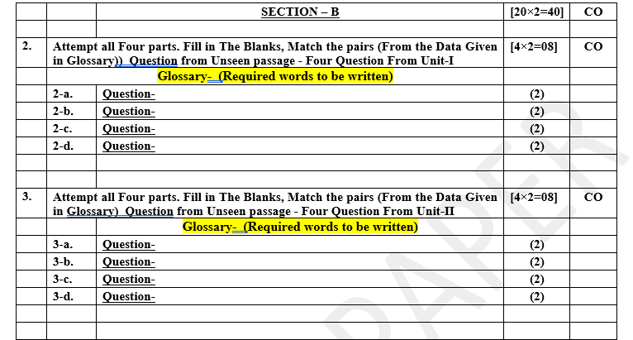
Pattern of Online External Exam Question Paper (100 marks)

Slide 22

Pattern of Online External Exam Question Paper (100 marks)

Slide 23

Pattern of Online External Exam Question Paper (100 marks)

Slide 24
Prerequisite / Recap
Student should have knowledge of Web technology and terminology.
Knowledge of HTML ,CSS and Java Script required .
knowledge of Programing language such as C/C++/Python etc.
Good problem solving Skill .

Slide 25
Brief Introduction about the Subject with videos
YouTube /Other Video Links
https://youtu.be/BLl32FvcdVM
https://youtu.be/v9ejT8FO-7I?list=PLrhzvIcii6GNjpARdnO4ueTUAVR9eMBpc
https://youtu.be/VGLjQuEQgkI?list=PLt4nG7RVVk1h9lxOYSOGI9pcP3I5oblbx

Slide 26
Unit III Content
Typescript, Setup and installation,
Power of Types , Functions Function as types Optional and default parameters,
Arrow functions, Function overloading,
Access modifiers, Getters and setters,
Read-only & static, Abstract classes,
Interfaces, Extending and Implementing Interface,
Import and Export modules.

Slide 27
Unit III Objective
In Unit III, the students will be able to find
Power of Types , Functions Function as types Optional and default parameters
Define Arrow functions and Function overloading
Access modifiers, Getters and setters
Read-only & static and Abstract classes
Interfaces, Extending and Implementing Interface
Import and Export modules.

Slide 28
Topic Objective
Topic : Typescript, Setup and installation, Power of Types , Functions Function as types Optional and default parameters, Arrow functions, Function overloading,
In this topic, the students will gain , Power of Types , Functions Function as types Optional and default parameters as well as Arrow functions, Function overloading and many more.

Slide 29
AngularJS
What is AngularJS
Angular JS is an open source JavaScript framework that is used to build web applications. It can be freely used, changed and shared by anyone.
Angular Js is developed by Google.
It is an excellent framework for building single phase applications and line of business applications.

Slide 30
TYPESCRIPT
Why TypeScript?
JavaScript is a dynamic programming language with no type system.
JavaScript provides primitive types like string, number, object, etc., but it doesn't check assigned values.
JavaScript variables are declared using the var keyword, and it can point to any value. JavaScript doesn't support classes and other object-oriented features (ECMA2015 supports it).
So, without the type system, it is not easy to use JavaScript to build complex applications with large teams working on the same code.

Slide 31
TYPESCRIPT
TypeScript is an open-source, object-oriented language developed and maintained by Microsoft, licensed under Apache 2 license.
TypeScript extends JavaScript by adding data types, classes, and other object-oriented features with type-checking.
It is a typed superset of JavaScript that compiles to plain JavaScript.
The type system increases the code quality, readability and makes it easy to maintain and refactor codebase. More importantly, errors can be caught at compile time rather than at runtime.
Hence, the reason to use TypeScript is that it catches errors at compile-time, so that you can fix it before you run code. It supports object-oriented programming features like data types, classes, enums, etc., allowing JavaScript to be used at scale.

Slide 32
TYPESCRIPT
TypeScript compiles into simple JavaScript.
The TypeScript compiler is also implemented in TypeScript and can be used with any browser or JavaScript engines like Node.js.
TypeScript needs an ECMAScript 3 or higher compatible environment to compile.
This is a condition met by all major browsers and JavaScript engines today.
Some of the most popular JavaScript frameworks like Angular.js and WinJS are written in TypeScript.

Slide 33

TYPESCRIPT
How to use TypeScript?
TypeScript code is written in a file with .ts extension and then compiled into JavaScript using the TypeScript compiler.
A TypeScript file can be written in any code editor.
A TypeScript compiler needs to be installed on your platform.
Once installed, the command tsc <filename>.ts compiles the TypeScript code into a plain JavaScript file.
JavaScript files can then be included in the HTML and run on any browser.
Compile TypeScript to JavaScrip

Slide 34
TYPESCRIPT
TypeScript Features
Cross-Platform: TypeScript runs on any platform that JavaScript runs on. The TypeScript compiler can be installed on any Operating System such as Windows, macOS, and Linux.
Object-Oriented Language: TypeScript provides powerful features such as Classes, Interfaces, and Modules. You can write pure object-oriented code for client-side as well as server-side development.
Static type-checking: TypeScript uses static typing. This is done using type annotations. It helps type checking at compile time. Thus, you can find errors while typing the code without running your script each time. Additionally, using the type inference mechanism, if a variable is declared without a type, it will be inferred based on its value.
Optional Static Typing: TypeScript static typing is optional, if you prefer to use JavaScript's dynamic typing.

Slide 35
TYPESCRIPT
TypeScript Advantages
TypeScript is an open-source language with continuous development and maintenance by Microsoft.
TypeScript runs on any browser or JavaScript engine.
TypeScript is similar to JavaScript and uses the same syntax and semantics. All of TypeScript's code finally gets converted into JavaScript. This allows a quicker learning curve for front-end developers currently coding in JavaScript.
TypeScript is also closer in syntax to backend languages like Java and Scala. This helps backend developers write front-end code faster.
TypeScript code can be called from an existing JavaScript code. TypeScript also works with existing JavaScript frameworks and libraries without any issues.

Slide 36
Install TypeScript
There are three ways to install TypeScript:
Install TypeScript as an NPM package on your local machine or in your project.
Install TypeScript NuGet Package in your .NET or .NET Core project.
Install TypeScript as a Plug-in in your IDE (Integrated Development Environment).

Slide 37
Install TypeScript
Install TypeScript using NPM:
NPM (Node.js package manager) is used to install the TypeScript package on your local machine or a project.
Make sure you have Node.js install on your local machine. If you are using JavaScript frameworks for your application, then it is highly recommended to install Node.js.
To install or update the latest version of TypeScript, open command prompt/terminal and type the following command:
npm install -g typescript
Execute the following command to install the TypeScript to your local project as dev dependency.
npm install typescript --save-dev

Slide 38
Install TypeScript
Install TypeScript as NuGet Package
For .NET or .NET Core projects, TypeScript can be installed as a NuGet package in your project.
The NuGet package Microsoft.TypeScript.MSBuild
MSBuild task for TypeScript, which will automatically compile all .ts files to .js files as per tsconfig.json configuration when you build your project.
To install the TypeScript NuGet package, open NuGet Package Manager by right-clicking on a project node, click Manage NuGet Packages.., and search for typescript in the Browse tab.
It will list all the packages related to TypeScript. Select Microsoft.TypeScript.MSBuild and click on the Install button.
This will install TypeScript in your local ASP.NET project.

Slide 39
Install TypeScript
TypeScript Visual Studio Extension
If your project type does not support the NuGet packages, then you can use TypeScript Visual Studio Extension. You can find and install the extension in Visual Studio from Tools > Extensions and Updates menu.
Visual Studio Code comes with built-in support for TypeScript.

Slide 40
Install TypeScript
Install TypeScript Plug-in in your IDE
You can install an IDE specific TypeScript package or plugin for your IDE.
A few examples of plugins for popular code editors are:
Atom-TypeScript: a TypeScript language service for Atom developed by TypeStrong.
TypeScript IDE for Eclipse: an Eclipse plugin developed by Angelo Zerr.
TypeScript Plug-in for Eclipse: an Eclipse plugin developed by Palantir.
WebStorm includes TypeScript support out of the box.

Slide 41
Install TypeScript
TypeScript Playground
TypeScript provides an online playground https://www.typescriptlang.org/play to write and test your code on the fly without the need to download or install anything.
This is a great place for beginners to learn TypeScript and try different TypeScript features.
You also have the option to share your code via a shareable link provided by the playground.

Slide 42
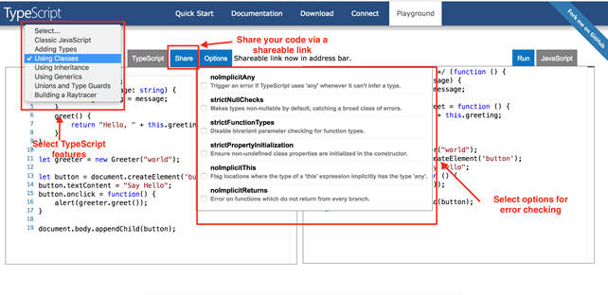
Install TypeScript

Slide 43
TypeScript - Functions
TypeScript - Functions
Functions are the primary blocks of any program. In JavaScript, functions are the most important part since the JavaScript is a functional programming language.
With functions, you can implement/mimic the concepts of object-oriented programming like classes, objects, polymorphism, and, abstraction.
Functions ensure that the program is maintainable and reusable, and organized into readable blocks. While TypeScript provides the concept of classes and modules, functions still are an integral part of the language.
In TypeScript, functions can be of two types:
named
anonymous.

Slide 44
TypeScript - Functions
Named Functions:
A named function is one where you declare and call a function by its given name.
function display() {
console.log("Hello TypeScript!");
}
display(); //Output: Hello TypeScript
Functions can also include parameter types and return type
function Sum(x: number, y: number) : number {
return x + y;
}
Sum(2,3); // returns 5

Slide 45
TypeScript - Functions
Anonymous Function:
An anonymous function is one which is defined as an expression. This expression is stored in a variable. So, the function itself does not have a name. These functions are invoked using the variable name that the function is stored in.
let greeting = function() {
console.log("Hello TypeScript!");
};
greeting(); // Output: Hello TypeScript!
An anonymous function can also include parameter types and return type
Function with Paramter and Return Types Copy
let Sum = function(x: number, y: number) : number
{
return x + y;
}
Sum(2,3); // returns 5

Slide 46
TypeScript - Functions
Function Parameters
Parameters are values or arguments passed to a function.
In TypeScript, the compiler expects a function to receive the exact number and type of arguments as defined in the function signature.
If the function expects three parameters, the compiler checks that the user has passed values for all three parameters i.e. it checks for exact matches.
EXAMPLE
function Greet(greeting: string, name: string ) : string {
return greeting + ' ' + name + '!';
}
Greet('Hello','Steve');//OK, returns "Hello Steve!"
Greet('Hi'); // Compiler Error: Expected 2 arguments, but got 1.
Greet('Hi','Bill','Gates'); //Compiler Error: Expected 2 arguments, but got 3.
This is unlike JavaScript, where it is acceptable to pass less arguments than what the function expects. The parameters that don't receive a value from the user are considered as undefined.

Slide 47
Function as types Optional and default parameters
Optional Parameters:
TypeScript has an optional parameter functionality.
The parameters that may or may not receive a value can be appended with a '?' to mark them as optional.
All optional parameters must follow required parameters and should be at the end.
Example: Optional Parameter
function Greet(greeting: string, name?: string ) : string {
return greeting + ' ' + name + '!';
}
Greet('Hello','Steve');//OK, returns "Hello Steve!"
Greet('Hi'); // OK, returns "Hi undefined!".
Greet('Hi','Bill','Gates'); //Compiler Error: Expected 2 arguments, but got 3.
In the above example, the second parameter name is marked as optional with a question mark appended at the end. Hence, the function Greet() accepts either 1 or 2 parameters and returns a greeting string. If we do not specify the second parameter then its value will be undefined

Slide 48
Function as types Optional and default parameters
Default Parameters
TypeScript provides the option to add default values to parameters. So, if the user does not provide a value to an argument, TypeScript will initialize the parameter with the default value.
Default parameters have the same behaviour as optional parameters.
If a value is not passed for the default parameter in a function call, the default parameter must follow the required parameters in the function signature.
Example: Default Parameter
function Greet(name: string, greeting: string = "Hello") : string {
return greeting + ' ' + name + '!';
}
Greet('Steve');//OK, returns "Hello Steve!"
Greet('Steve', 'Hi'); // OK, returns "Hi Steve!".
Greet('Bill'); //OK, returns "Hello Bill!"
When the default parameters precede required parameters in a function, they can be called by passing undefined.

Slide 49
TypeScript - Arrow Functions
Fat arrow notations are used for anonymous functions i.e for function expressions.
They are also called lambda functions in other languages.
Syntax:
(param1, param2, ..., paramN) => expression
Using fat arrow =>, we dropped the need to use the function keyword. Parameters are passed in the parenthesis (), and the function expression is enclosed within the curly brackets { }.
let sum = (x: number, y: number): number => {
return x + y;
}
sum(10, 20); //returns 30

Slide 50
TypeScript - Arrow Functions
In the above example, sum is an arrow function. (x:number, y:number) denotes the parameter types, :number specifies the return type.
The fat arrow => separates the function parameters and the function body.
The right side of => can contain one or more code statements.
The above arrow function sum will be converted into the following JavaScript code.
var sum = function (x, y) {
return x + y;
}
Example: Parameterless Arrow Function Copy
let Print = () => console.log("Hello TypeScript");
Print(); //Output: Hello TypeScript
Furthermore, if the function body consists of only one statement then no need for the curly brackets and the return keyword, as shown below.
let sum = (x: number, y: number) => x + y;
sum(3, 4); //returns 7

Slide 51
TypeScript - Arrow Functions
A class can include an arrow function as a property, as shown below.
Example: Arrow Function in Class
class Employee {
empCode: number;
empName: string;
constructor(code: number, name: string) {
this.empName = name;
this.empCode = code;
}
display = () => console.log(this.empCode +' ' + this.empName)
}
let emp = new Employee(1, 'Ram');
emp.display();

Slide 52
TypeScript - Function Overloading
TypeScript provides the concept of function overloading. You can have multiple functions with the same name but different parameter types and return type. However, the number of parameters should be the same.
function add(a:string, b:string):string;
function add(a:number, b:number): number;
function add(a: any, b:any): any {
return a + b;
}
add("Hello ", "Steve"); // returns "Hello Steve"
add(10, 20); // returns 30

Slide 53
TypeScript - Function Overloading
In the above example, we have the same function add() with two function declarations and one function implementation.
The first signature has two parameters of type string, whereas the second signature has two parameters of the type number.
The last function should have the function implementation.
Since the return type can be either string or number as per the first two function declarations, we must use compatible parameters and return type as any in the function definition.
Function overloading with different number of parameters and types with same name is not supported
Thus, in order to achieve function overloading, we must declare all the functions with possible signatures. Also, function implementation should have compatible types for all declarations.

Slide 54
Topic Objective
Topic : Access modifiers, Getters and setters, Read-only & static, Abstract classes.
Interfaces,In this topic, the students will gain , Access modifiers, Getters and setters, Read-only & static, Abstract classes. and many more.

Slide 55
Access modifiers
In object-oriented programming, the concept of 'Encapsulation' is used to make class members public or private i.e. a class can control the visibility of its data members. This is done using access modifiers.
There are three types of access modifiers in TypeScript: public, private and protected.
public
By default, all members of a class in TypeScript are public. All the public members can be accessed anywhere without any restrictions.
class Employee {
public empCode: string;
empName: string;
}
let emp = new Employee();
emp.empCode = 123;
emp.empName = "Swati";

Slide 56
Access modifiers
In the above example, empCode and empName are declared as public. So, they can be accessible outside of the class using an object of the class.
Please notice that there is not any modifier applied before empName, as TypeScript treats properties and methods as public by default if no modifier is applied to them.

Slide 57
Access modifiers
private
The private access modifier ensures that class members are visible only to that class and are not accessible outside the containing class.
Example: private Copy
class Employee {
private empCode: number;
empName: string;
}
let emp = new Employee();
emp.empCode = 123; // Compiler Error
emp.empName = "Swati";//OK
In the above example, we have marked the member empCode as private. Hence, when we create an object emp and try to access the emp.empCode member, it will give an error.

Slide 58
Access modifiers
protected
The protected access modifier is similar to the private access modifier, except that protected members can be accessed using their deriving classes.
class Employee {
public empName: string;
protected empCode: number;
constructor(name: string, code: number){
this.empName = name;
this.empCode = code;
}
}
conti...

Slide 59
Access modifiers
contii...
SalesEmployee extends Employee{
private department: string;
constructor(name: string, code: number, department: string) {
super(name, code);
this.department = department;
}
}
let emp = new SalesEmployee("John Smith", 123, "Sales");
emp.empCode; //Compiler Error
In the above example, we have a class Employee with two members, public empName and protected property empCode. We create a subclass SalesEmployee that extends from the parent class Employee. If we try to access the protected member from outside the class, as emp.empCode, we get the following compilation error:
error TS2445: Property 'empCode' is protected and only accessible within class 'Employee' and its subclasses.

Slide 60
Read-only & static
ReadOnly
TypeScript includes the readonly keyword that makes a property as read-only in the class, type or interface.
Prefix readonly is used to make a property as read-only. Read-only members can be accessed outside the class, but their value cannot be changed.
Since read-only members cannot be changed outside the class, they either need to be initialized at declaration or initialized inside the class constructor.
Example
class Employee {
readonly empCode: number;
empName: string;
constructor(code: number, name: string) {
this.empCode = code;
this.empName = name;
}
}
let emp = new Employee(10, "John");
emp.empCode = 20; //Compiler Error
emp.empName = 'Bill';

Slide 61
Read-only & static
In the above example, we have the Employee class with two properties- empName and empCode.
Since empCode is read only, it can be initialized at the time of declaration or in the constructor.
If we try to change the value of empCode after the object has been initialized, the compiler shows the following compilation error:
error TS2540: Cannot assign to empCode' because it is a constant or a read-only property.

Slide 62
Read-only & static
Static
ES6 includes static members and so does TypeScript. The static members of a class are accessed using the class name and dot notation, without creating an object e.g. <ClassName>.<StaticMember>.
The static members can be defined by using the keyword static. Consider the following example of a class with static property.

Slide 63
Read-only & static
The following example defines a class with static property and method and how to access it.
Example: Static Members
class Circle {
static pi: number = 3.14;
static calculateArea(radius:number) {
return this.pi * radius * radius;
}
}
Circle.pi; // returns 3.14
Circle.calculateArea(5); // returns 78.5
The above Circle class includes a static property and a static method. Inside the static method calculateArea, the static property can be accessed using this keyword or using the class name Circle.pi.

Slide 64
TypeScript - Abstract Class
Define an abstract class in Typescript using the abstract keyword. Abstract classes are mainly for inheritance where other classes may derive from them. We cannot create an instance of an abstract class.
An abstract class typically includes one or more abstract methods or property declarations. The class which extends the abstract class must define all the abstract methods.
The following abstract class declares one abstract method find and also includes a normal method display.

Slide 65
TypeScript - Abstract Class
abstract class Person {
abstract name: string;
display(): void{
console.log(this.name);
}}
class Employee extends Person {
name: string;
empCode: number;
constructor(name: string, code: number) {
super(); // must call super()
this.empCode = code;
this.name = name; }}
let emp: Person = new Employee("James", 100);
emp.display(); //James

Slide 66
Topic Objective
Topic : Extending and Implementing Interface, Import and Export modules.
Interfaces,In this topic, the students will gain , Extending and Implementing Interface, Import and Export modules and many more.

Slide 67
TypeScript -Interfaces
Interface is a structure that defines the contract in your application. It defines the syntax for classes to follow.
Classes that are derived from an interface must follow the structure provided by their interface.
The TypeScript compiler does not convert interface to JavaScript. It uses interface for type checking.
This is also known as "duck typing" or "structural subtyping".
An interface is defined with the keyword interface and it can include properties and method declarations using a function

Slide 68
TypeScript -Interfaces
interface KeyPair {
key: number;
value: string;
}
let kv1: KeyPair = { key:1, value:"Steve" }; // OK
let kv2: KeyPair = { key:1, val:"Steve" }; // Compiler Error: 'val' doesn't exist in type 'KeyPair'
let kv3: KeyPair = { key:1, value:100 }; // Compiler Error:

Slide 69
TypeScript -Interfaces
The following interface IEmployee defines a type of a variable.
Example: Interface as Type
interface KeyPair {
key: number;
value: string;
}
let kv1: KeyPair = { key:1, value:"Steve" }; // OK
let kv2: KeyPair = { key:1, val:"Steve" }; // Compiler Error: 'val' doesn't exist in type 'KeyPair'
let kv3: KeyPair = { key:1, value:100 }; // Compiler Error:

Slide 70
TypeScript -Interfaces
In the above example, an interface KeyPair includes two properties key and value. A variable kv1 is declared as KeyPair type.
So, it must follow the same structure as KeyPair.
It means only an object with properties key of number type and value of string type can be assigned to a variable kv1.
The TypeScript compiler will show an error if there is any change in the name of the properties or the data type is different than KeyPair.
Another variable kv2 is also declared as KeyPair type but the assigned value is val instead of value, so this will cause an error.
In the same way, kv3 assigns a number to the value property, so the compiler will show an error.
Thus, TypeScript uses an interface to ensure the proper structure of an object.

Slide 71
Extending and Implementing Interface
Extending Interfaces
Interfaces can extend one or more interfaces. This makes writing interfaces flexible and reusable.
Example: Extend Interface
interface IPerson {
name: string;
gender: string; }
interface IEmployee extends IPerson {
empCode: number; }
let empObj:IEmployee = {
empCode:1,
name:"Bill",
gender:"Male"}

Slide 72
Extending and Implementing Interface
In the above example, the IEmployee interface extends the IPerson interface.
So, objects of IEmployee must include all the properties and methods of the IPerson interface otherwise, the compiler will show an error.

Slide 73
Extending and Implementing Interface
Implementing an Interface:
Similar to languages like Java and C#, interfaces in TypeScript can be implemented with a Class.
The Class implementing the interface needs to strictly conform to the structure of the interface.

Slide 74
Extending and Implementing Interface
Implementing an Interface:
interface IEmployee {
empCode: number;
name: string;
getSalary:(empCode: number) => number;}
class Employee implements IEmployee {
empCode: number;
name: string;
constructor(code: number, name: string) {
this.empCode = code;
this.name = name;}
getSalary(empCode:number):number {
return 20000;
}}
let emp = new Employee(1, "Steve");

Slide 75
Extending and Implementing Interface
In the above example, the IEmployee interface is implemented in the Employee class using the the implement keyword.
The implementing class should strictly define the properties and the function with the same name and data type.
If the implementing class does not follow the structure, then the compiler will show an error.
Of course, the implementing class can define extra properties and methods, but at least it must define all the members of an interface.

Slide 76
Import and Export modules
TypeScript provides modules and namespaces in order to prevent the default global scope of the code and also to organize and maintain a large code base.
Modules are a way to create a local scope in the file. So, all variables, classes, functions, etc. that are declared in a module are not accessible outside the module.
A module can be created using the keyword export and a module can be used in another module using the keyword import.

Slide 77
Import and Export modules
In TypeScript, files containing a top-level export or import are considered modules. For example, we can make the above files as modules as below.
file1.ts
export var greeting : string = "Hello World!";
file2.ts
console.log(greeting); //Error: cannot find 'greeting'
greeting = "Hello TypeScript";
In file1.ts, we used the keyword export before the variable. Now, accessing a variable in file2.ts will give an error. This is because greeting is no longer in the global scope.
In order to access greeting in file2.ts, we must import the file1 module into file2 using the import keyword.

Slide 78
Import and Export modules
In TypeScript, files containing a top-level export or import are considered modules. For example, we can make the above files as modules as below.
file1.ts
export var greeting : string = "Hello World!";
file2.ts
console.log(greeting); //Error: cannot find 'greeting'
greeting = "Hello TypeScript";
In file1.ts, we used the keyword export before the variable. Now, accessing a variable in file2.ts will give an error. This is because greeting is no longer in the global scope.
In order to access greeting in file2.ts, we must import the file1 module into file2 using the import keyword.

Slide 79
Import and Export modules
Export Module
A module can be defined in a separate .ts file which can contain functions, variables, interfaces and classes. Use the prefix export with all the definitions you want to include in a module and want to access from other modules.
Employee.ts
export let age : number = 20;
export class Employee {
empCode: number;
empName: string;
constructor(name: string, code: number) {
this.empName = name;
this.empCode = code; }
displayEmployee() {
console.log ("Employee Code: " + this.empCode + ", Employee Name: " + this.empName ); }}
let companyName:string = "XYZ";.

Slide 80
Import and Export modules
In the above example, Employee.ts is a module which contains two variables and a class definition.
The age variable and the Employee class are prefixed with the export keyword, whereas companyName variable is not.
Thus, Employee.ts is a module which exports the age variable and the Employee class to be used in other modules by importing the Employee module using the import keyword.
The companyName variable cannot be accessed outside this Employee module, as it is not exported.

Slide 81
Import and Export modules
Import Module
A module can be used in another module using an import statement.
Syntax:
Import { export name } from "file path without extension"

Slide 82
Import and Export modules
Import Module
Importing a Single export from a Module:
We exported a variable and a class in the Employee.ts. However, we can only import the export module which we are going to use. The following code only imports the Employee class from Employee.ts into another module in the EmployeeProcessor.ts file.
EmployeeProcessor.ts Copy
import { Employee } from "./Employee";
let empObj = new Employee("Steve Jobs", 1);
empObj.displayEmployee(); //Output: Employee Code: 1, Employee Name: Steve Jobs

Slide 83
Import and Export modules
Importing Module into Variable
You can import all the exports in a module as shown below.
EmployeeProcessor.ts
import * as Emp from "./Employee"
console.log(Emp.age); // 20
let empObj = new Emp.Employee("Bill Gates" , 2);
empObj.displayEmployee(); //Output: Employee Code: 2, Employee Name: Bill Gates
In the above example, we import all the exports in Employee module in a single variable called Emp.
So, we don't need to write an export statement for each individual module. In the above example, it will import age and Employee class into the Emp variable and can be accessed using Emp.age and Emp.Employee.

Slide 84
Import and Export modules
Renaming Export Module
You can change the name of an export as shown below.
EmployeeProcessor.ts Copy
import { Employee as Associate } from "./Employee"
let obj = new Associate("James Bond" , 3);
obj.displayEmployee();//Output: Employee Code: 3, Employee Name: James Bond
In the above example, the name of Employee export class is changed to Associate using { employee as Associate }.
This is useful in assigning a more meaningful name to an export, as per your need which increases the readability.

Slide 85
Daily Quiz
Q 1 - TypeScript is ?
A)Case-sensitive
B)Case-insensitive
C)depends on typescript version
D)None of the above
Q 2 - ypeScript supports how many types of comments?
1
2
3
4
Q 3 -What are the three main 'simple types' in TypeScript?
Object, Array, Symbol Your answer
Array, Object, Boolean
Object, String, Number
Boolean, Number, String

Slide 86
Daily Quiz
Q 4 - TypeScript can always correctly infer a variables type.
False
True
Q 5 - What does the 'readonly' access modifier do for an array variable assignment like: `const codeNames: readonly string[] = ['Coding', 'God']`?
Allows only adding but not deleting elements in the array Your answer
Makes you read it for better clean code
Allows no changes and is there simply to be read from and not modified
Makes it private and can only be used in the file its created

Slide 87
Weekly Assignment
What are the Benefits of using TypeScript?
How to install TypeScript?
How do you compile TypeScript files?
Can we combine multiple .ts files into a single .js file?
What are the different types of TypeScript?.

Slide 88
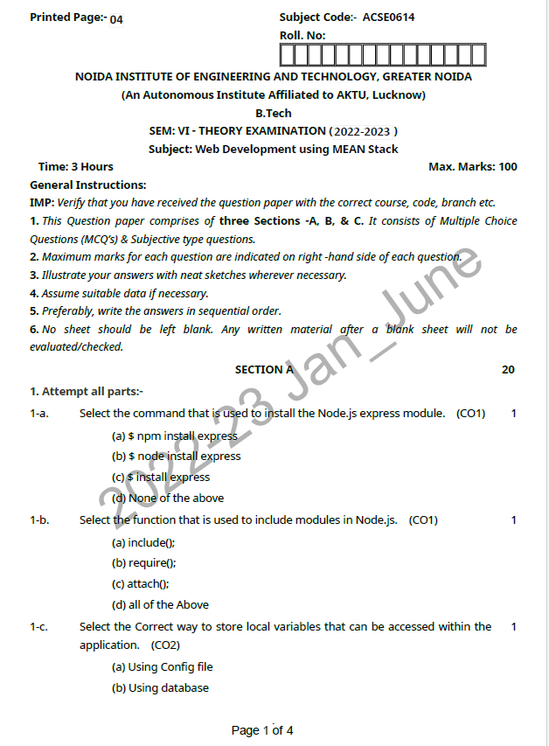

Previous Year Question paper

Slide 89
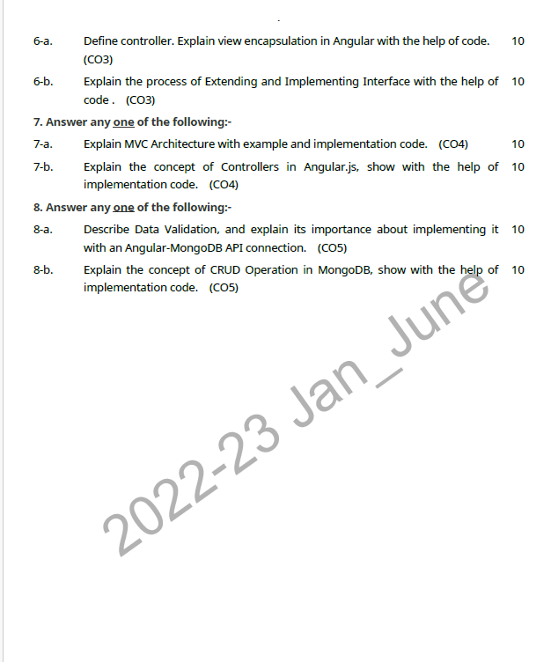
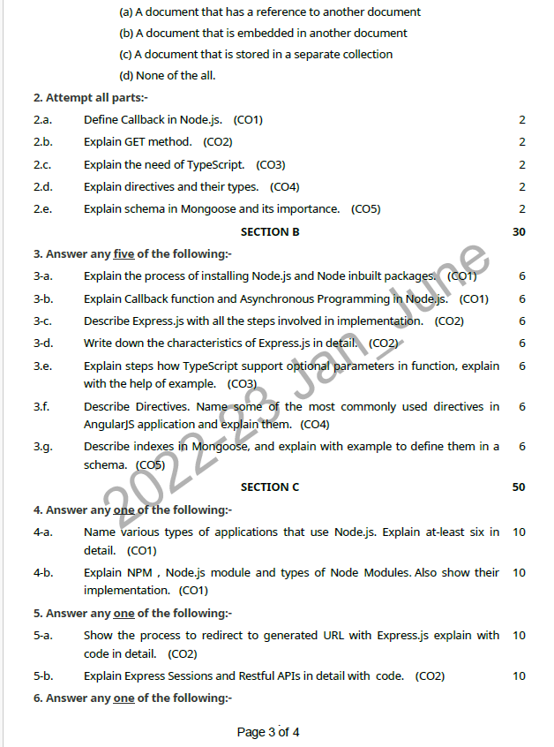
Previous Year Question paper(Contd…)

Slide 90
Topic Link ( YouTube & NPTEL Video Links)
YouTube /other Video Links
https://youtu.be/rI4kdGLaUiQ?list=PL6n9fhu94yhUbctIoxoVTrklN3LMwTCmd
https://youtu.be/v9ejT8FO-7I?list=PLrhzvIcii6GNjpARdnO4ueTUAVR9eMBpc
https://youtu.be/VGLjQuEQgkI?list=PLt4nG7RVVk1h9lxOYSOGI9pcP3I5oblbx

Slide 91
MCQ (End of Unit)
1.What are the two types of enums?
String and Number
Number and Number Array
String and Boolean
Number and Boolean
2.Access modifiers control the ______ of properties and methods.
type
inheritance
visibility
mocking

Slide 92
MCQ (End of Unit)
3.When a class extends another class and replaces the members of its parent it is called what?
override
inheriting
overload
extending
4. Protected modifiers only are allowed in the inherited class.
True
False

Slide 93
Glossary Questions
Top 10 design pattern interview questions
Why do we need TypeScript
Mention some of the features of TypeScript?
What are the Benefits of using TypeScript?
How to install TypeScript?
How do you compile TypeScript files?
Can we combine multiple .ts files into a single .js file?
What are the different types of TypeScript?
List out the built-in data types in TypeScript.?
What are Variables in TypeScript and how to create them.
What are the different ways of declaring a Variable??

Slide 94
Expected Questions for University Exam
What are Interfaces in TypeScript?
What are the access modifiers supported by TypeScript?
What are modules in TypeScript?
Does TypeScript support function overloading?
Differentiate ordinary and abstract factory design patterns.
How does TypeScript support optional parameters in function?
What is the Default Parameters Function in TypeScript?
What is the difference between interface and type statements?

Slide 95
Summary
Till Now we understand, How to Install typescript, Power of Types and its Functions. We lear about Function as types Optional and default parameters
Define Arrow functions and Function overloading. Different types of Access modifiers, Getters and setters Read-only & static are studied . Abstract classes
Interfaces, Extending and Implementing Interface also in typescript. How to
Import and Export modules are alsostudied .

Slide 96
References
Simon Holmes, Clive Herber, “Getting MEAN with Mongo, Express, Angular, and Node”, 2nd Edition 2016, Addison Wesley Publication.
Dhruti Shah, “Comprehensive guide to learn Node.js”, 1st Edition, 2018 BPB Publications.
Christoffer,Noring,Pablo,Deeleman,“Learning Angular”,3rd Edition,2017 Packt publications. .
Peter Membrey, David Hows, Eelco Plugge, “MongoDB Basics”, 2nd edition, 2018, International Publication.
Christoffer Noring, Pablo Deeleman, “Learning Angular”,3rd Edition,

Slide 97
THANK YOU

